Slide 1
Summary
Our idea is to make a portable device that could sense when the milk is about to boil and buzzer an alarm so that we can know few minutes before. After hearing alarm we can go and stop it, there is no need to attend the milk till it boils. It would be a great relief to us from the stress to attend the milk till it boils. It would also reduce our work that gets added due to overflowed milk. It allows us to concentrate on other works also. We can set the sensor level so the user can decide the degree of boiling.

Slide 2
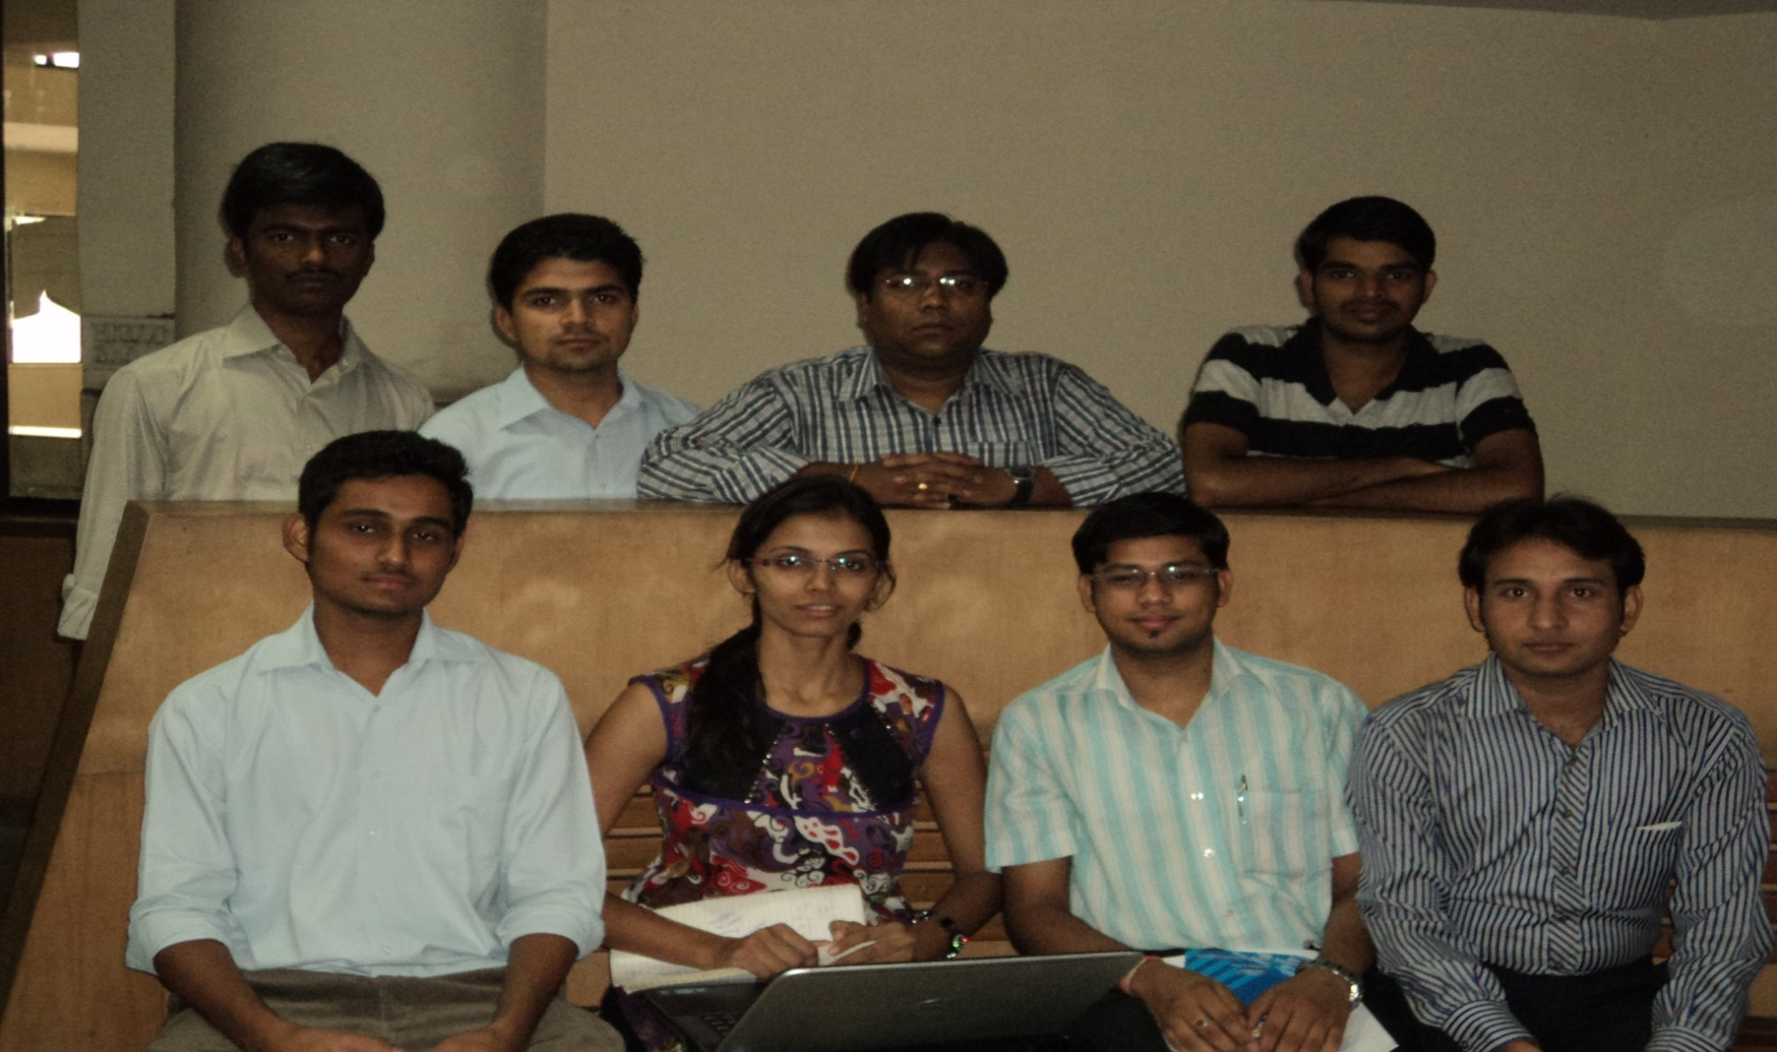
( esperanto for creativity )
KREEMO
Saravan,Navdeep,Krunal,Randeep.Himanshu,Ami,Arpit,Saket

Slide 3
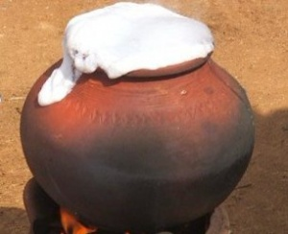
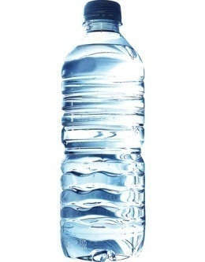
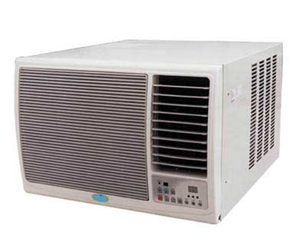
Top 3 Ideas
Controlling the spilling when boiling milk.
Portable heating/cooling device for plastic water bottles.
Utilizing thermal discharge of an AC for heating water.

Slide 4
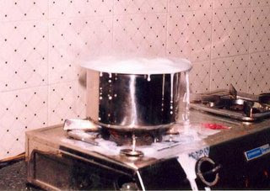
Pain Area
Milk is a part and parcel of Indian households, and so is boiling it.
Often, when left unattended, milk spills during boiling.

Slide 5
Our Idea
Our idea is to make a portable device that could sense when the milk is about to boil and buzzer an alarm so that we can know few minutes before so that we can go and stop it and we don’t need to attend the milk till it boils.
It would relief us from the stress to attend the milk till it boils.
It would also reduce our work that gets added due to overflowed milk.

Slide 6
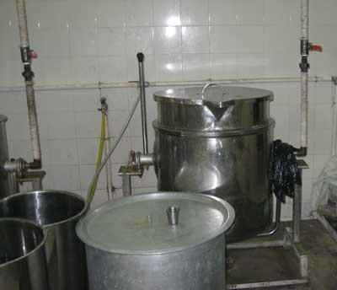
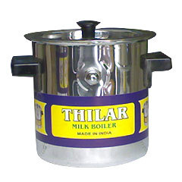
Why this idea?
Impact
- Cost , time and Workload
effective for a wider consumer group.
Market
- Majority of Milk Consuming Indian households
Competition
- Milk Boilers/Cooker manufacturing companies

Slide 7
Cause Effect Diagram
Environment
Material
Methods
Disturbances
Varieties of Milk
Traditional Methods
Distractions
Milk Boilers /Cookers
Multi-Tasking
Electric Kettle
Working Women
Housewives
Size of Utensils
Students / Individuals
Simple Utensils
Multi-Tasking People
Spilling of Milk while boiling
People
Equipment

Slide 8
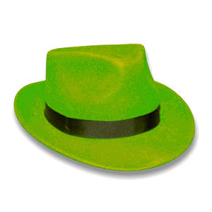
88% people find boiling milk tedious.
82% people are looking for an alternative.
Over boiling reduces nutritional value.
Crying over spilt milk
spilling milk: a bad omen
Overworked housewives
A well round food is wasted, so many sleep hungry
Milk level buzzer system
Milk temperature and level buzzer system
Complete Milk boiling automation.
Mountable on any open utensil
Standalone products already exist
Complexity of the product
Design of the product
Cleaning of the product
Time saved.
costs reduced
Milk demand controlled
More mouths fed
Notes:
(TOI, Chandigarh edition.)

Slide 9
Business Plan
Make the product compatible with simple open utensils
Get the product to cost considerably below the competing products; conveniently low to suffice:
COST(Our Product + a simple utensil) < COST(Competing product)

Slide 10
Help Needed?
Financial Help
-Investment on Sensors, buzzers, assembling, delivering.
Marketing Help
- Through utensil-sellers and milk vendors.
Strategic Knowhow
-Bridging emotionally through to consumers

Slide 11
TEAM
N. SARAVANA KUMAR | HINDUSTHAN COLLEGE OF ENGINEERING AND TECHNOLOGY, COIMBATORE
NAVDEEP GAUR | P. M. COLLEGE OF ENGINEERING, SONEPAT
Krunal
RANDEEP B | AIMIT, ST ALOYSIUS COLLEGE, MANGALORE
Himanshu | NOIDA INTERNATIONAL UNIVERSITY, NOIDA
AMI ATULBHAI DESAI | J P DAWAR INSTITUTE OF INFORMATION SCIENCE & TECHNOLOGY, SURAT
ARPIT DILIP PATEL | PANDIT DEENDAYAL PETROLEUM UNIVERSITY, GANDHINAGAR
Saket

